Slide 1

Team Details
Team Name: Averath Agricos
Team Leader Name: Shravani Shinde
Problem Statement: Biodegradable Pro-tray

Slide 2

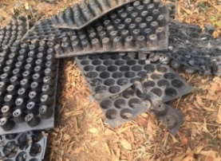
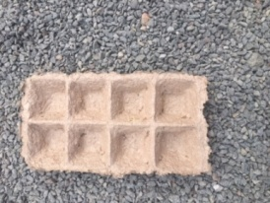
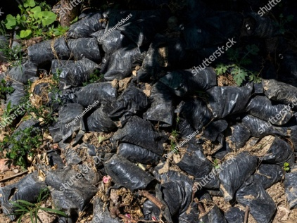
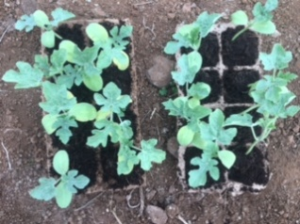
Brief about the idea : Replacing plastic nursery trays with Biodegradable trays with embeded starter root promoting Bio stimulants.
Problem and Proposed Solution
Problem
Chance of Seedling failure and Affect on agricultural soil.
Solution
Biodegradable tray
Cost – 10 Rs along inbuilt nutrition .
promote growth
Saves soil and have inbuilt nutrient .
Polyethylene pollution .
Cost – 9-10 Rs

Slide 3
Opportunities
Innovation/USP/Competitive Advantages
Key advantages over your competitors:
Biodegradability, avoid seedlings failure
Technology / Process Involved:
Blending with raw material and use high pressure hot pressing .
Validation:
Under processing and working on field trials
Sr. No | Raw material source | Metric data
1. | Sugarcane industry in India annual production | 35.5 crore tonnes
2. | Maharashtra annual production (bagasse recovery 40-50%) | 138.5 lakh tonnes (69.25 lakh tone bagasse available )
3. | Bagasse production in my locality (Kolhapur and sangli) | 12.5 lakh tone bagasse
4. | Karnataka areca production | 1100 metric tone
5. | Areca stem cells shredded per annum | 5400 million areca stem cells

Slide 4
List of features offered by the solution:
Features
Current Status
Agri Residue waste management.
Replacing plastic with biodegradable agri waste.
Embeded starter solution for root development.
Easy to transplant.
Low chances of seedling failure.
Reducing the initial soil drenching.
Cost effective.
Current data -
1. Composition process .(60:40 -Bagasse:areca Crush)
2. Prototype development .
3. Trial taken on watermelon and marigold-100% results .
4. Working on machine development for process.
5. Validation under processing for prototype developed.
6. Status of funding – own funds.

Slide 5
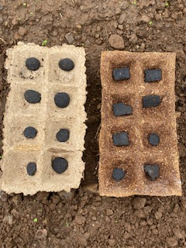
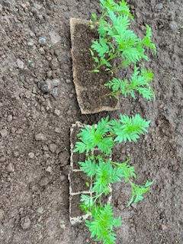
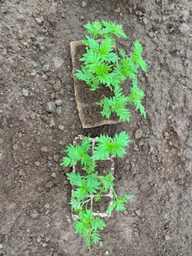
Mock diagrams of the proposed solution
Field Trials/ Product testing
Placing of Biochips
Trial for watermelon nursery
Trial for marigold nursery
Bagasse % | Areca stem cell % | Quality
50 40 65 60 | 50 60 35 40 | Not strengthen Harder Low strength Good strength
Composition proportion checked

Slide 6
Process flow diagram:
sugarcane bagasse
Collection and moisturize the bagasse. Then collect the sugar pulp which going to help in making sheet.
Sheet making
BDP
Addition of nutrient additives for the growth of seedling .
With the help of extracted pulp sheet is prepared
By press mechanism pro trays are made with the help of nutrients content pulp sheet and areca leaves
Natural drying of pro trays

Slide 7
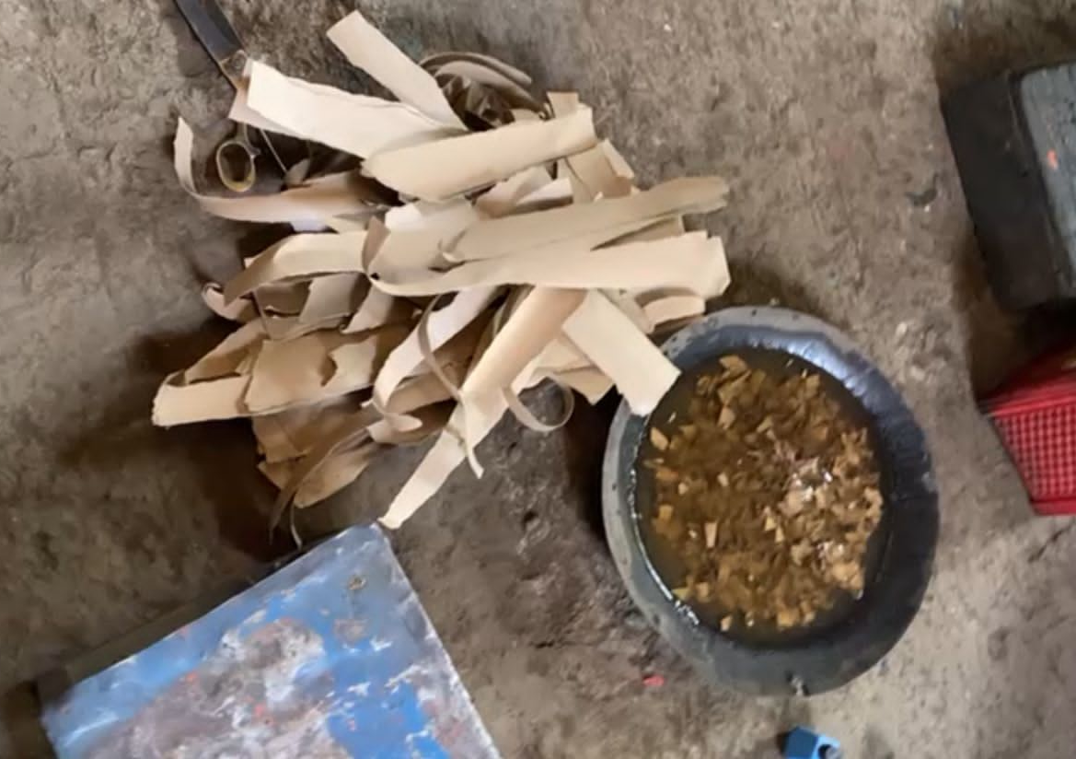
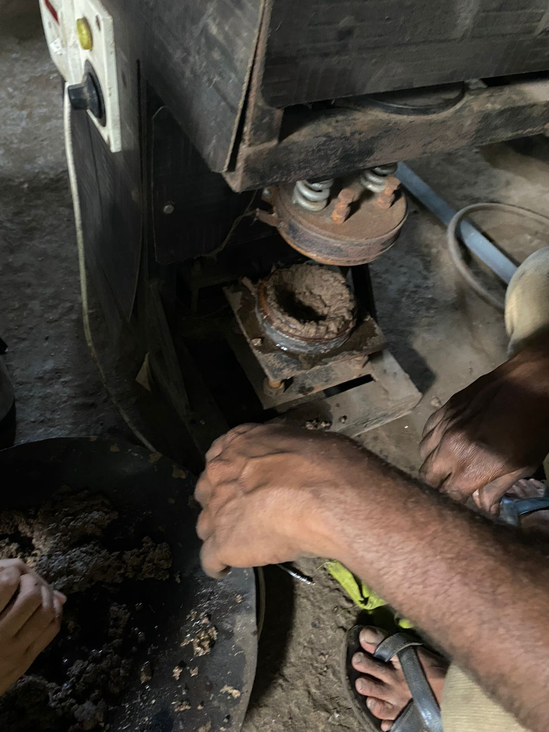
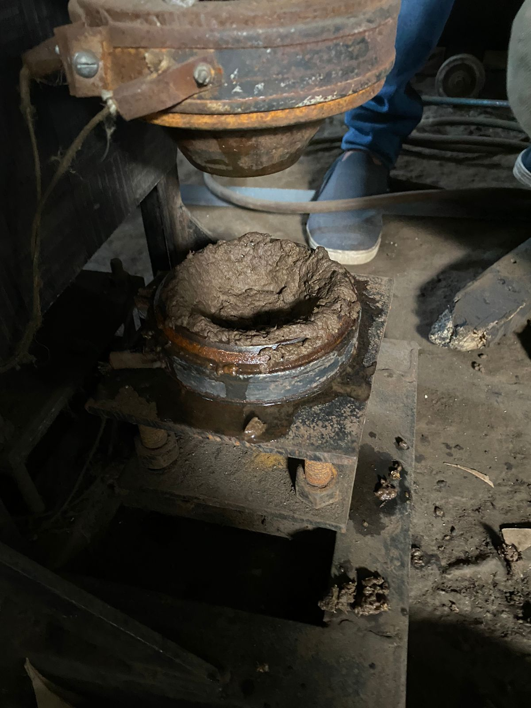
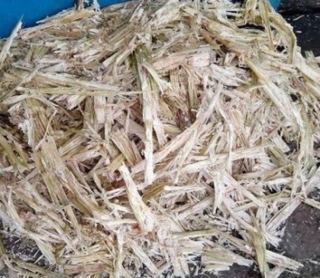
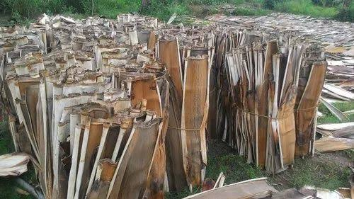
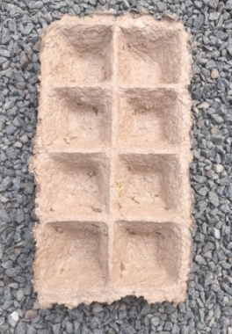
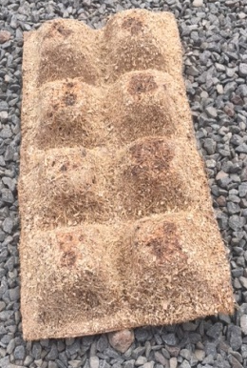
Technologies to be used in the solution
Raw material Collection
Crushing and Pulping
Pulp Molding
Hot Press
1.Trash
2.Wheat straw
3.Rice straw
4.Banana pseudo stem
5.Other crop residue on the basis of binding value.
Oven drying
Product

Slide 8
Estimated implementation cost :
Particulars | Description | Estimation ( in lacs)
Manpower | Mention type of Manpower (E.g. Product designer, Machine Operator, etc.) | 0.5
Equipment Purchase | Mention the type of machinery and capacity of machinery/equipment’s (pulper,dryer,different moulds) | 4.0
Working Capital | Eg - Rent, Utilities, Raw materials, electricity (baggase sheet , areca stem cells ) | 1.5
Marketing | Eg - Product refinement, Field trials, product launch, customer survey, incubation charge etc. (product devlopment ,trials ,patent ,launch ) | 2.0
Miscellaneous | Unforeseen expenses (shed ,working space) | 1.5
Total Project cost |  | 9.5

Slide 9
Business Model :
1.Target Customers:
Small scale and large scale nurseries
All group of farmers who take nursery at primary level ,FPO’s.
2.Competitors:
Polyethylene pro-tray industries
3.Go to Marketing Strategy:
Collaboration with nursery
Progressive farmers .
4.Pricing Strategy:
Rs.10 per portray which carry 100 cells .
(Note :as per need and requirement of farmer price can be changed with varying cell number)

Slide 10
Revenue Model :
Cost Price and Selling Price of your solution:
Cost price-Rs.6
Selling price-Rs .10
Project revenue for next 3 years:
NO.OF YEAR | SALE IN NO. | MARGIN | TOTAL
1 year | 1lakh | Rs.3/tray | Rs.3 lakh
2 year | 2 lakh | Rs.3.5/tray | Rs. 7 lakh
3 year | 3 lakh | Rs.4/tray | Rs.12 lakh

Slide 11


